Slide 1
Paperly - Research paper assistant
MSA 8700 GEN AI Solutions
Team Members
Mahitha Borra
Pancham Desai
Ruudra Patel
March 31, 2025

Slide 2
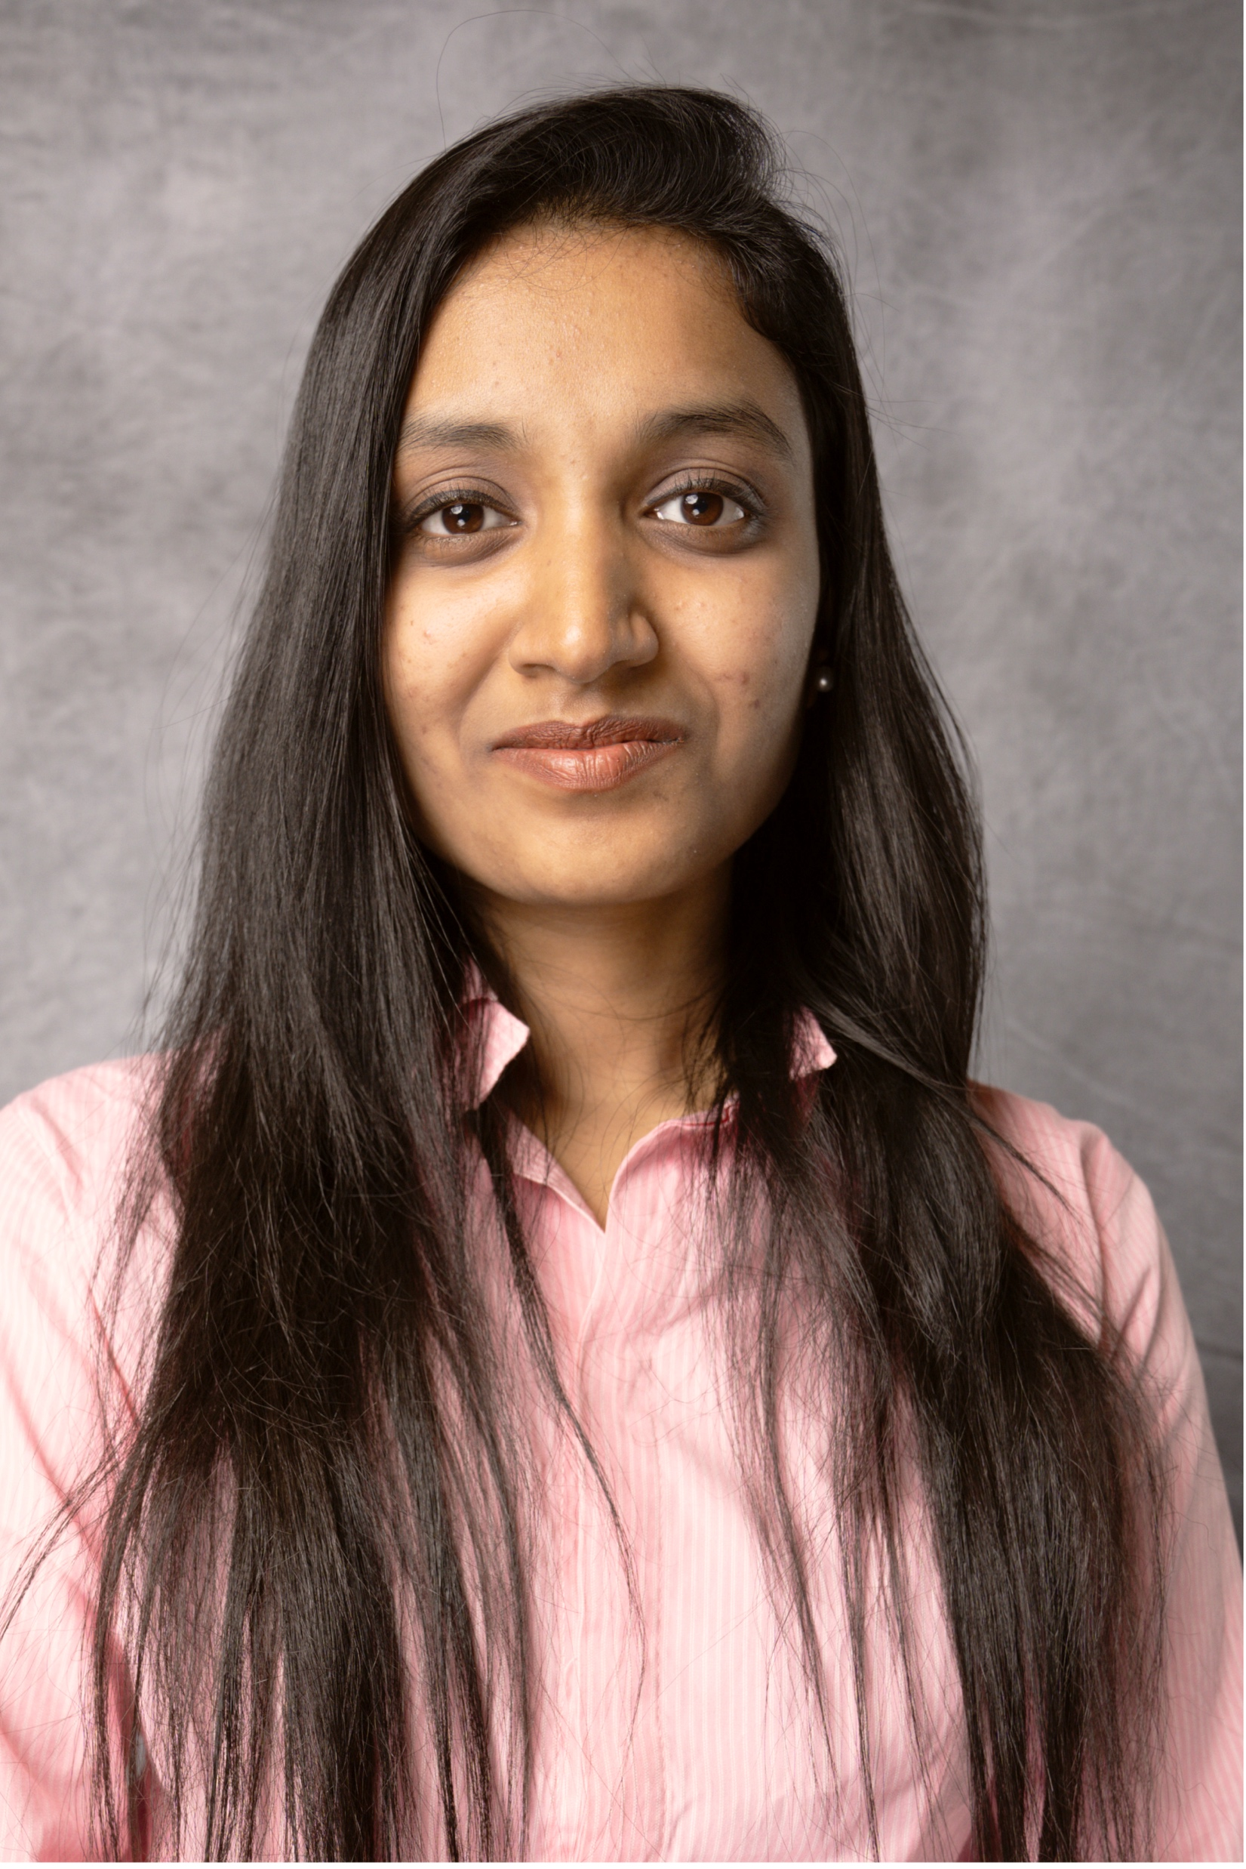

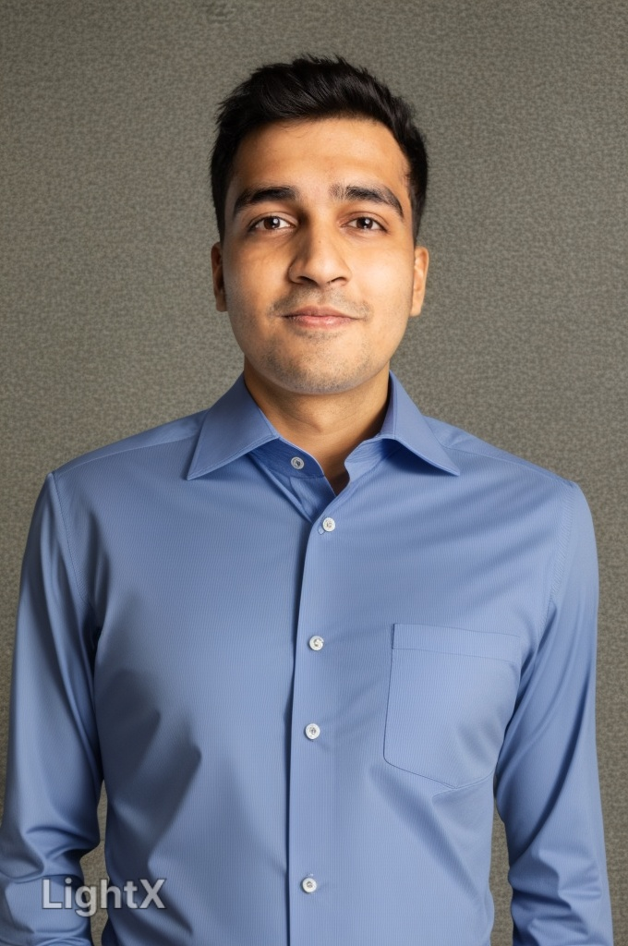
Team Members
Mahitha Borra
PanchamDesai
Ruudra Patel

Slide 3


Problem / Use-case
Problem Statement
Researchers, students, and professionals across academia and industry often face significant challenges in comprehending complex research papers due to dense technical language, lack of contextual knowledge. This hampers efficient knowledge acquisition and increases the cognitive load required to stay updated with the latest developments in a field.
Business Need
Organizations, universities, and R&D teams require an AI-powered tool that can ingest and interpret research papers, offering interactive summaries, Q&A functionality, and intelligent guidance to democratize access to complex knowledge and improve decision-making, research efficiency, and cross-domain collaboration.

Slide 4
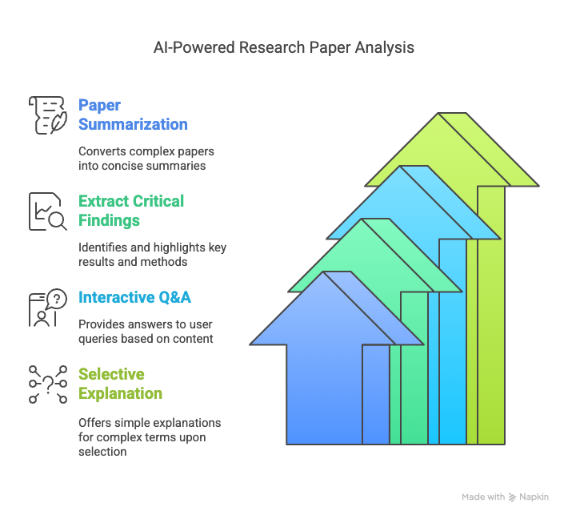
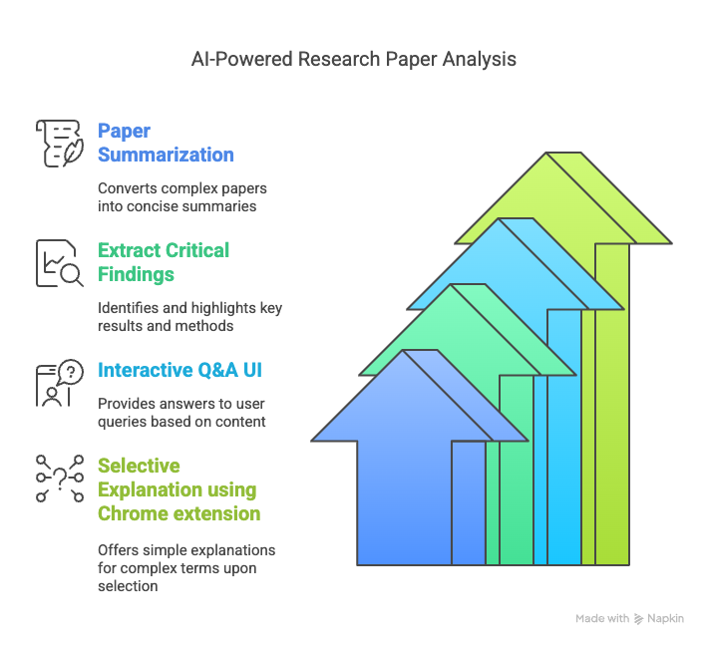
AI Solution
Features
Solution = Web Interface + Chrome Extension

Slide 5








Technologies

Slide 6
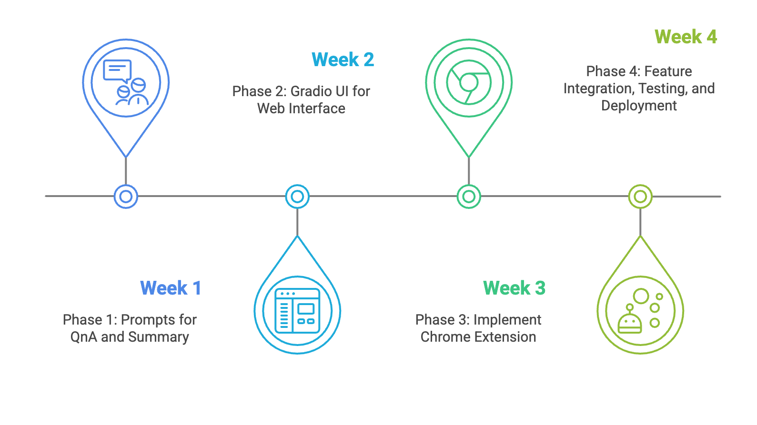
Project plan

Slide 7
Roles and Responsibilities
1) Mahitha Borra
Design and implement chrome extension for simple explanation of text based on user selection.
2) Pancham Desai
Design web UI, Build and fine-tune the core question-answering system using LLMs based on the context
3) Ruudra Patel
Develop a summarization module capable of distilling complex academic papers into clear, concise summaries.

Slide 8
Thank you

